Slide 1

The Almond milk dilemma
Notes:
You don’t need to be an expert

Slide 2
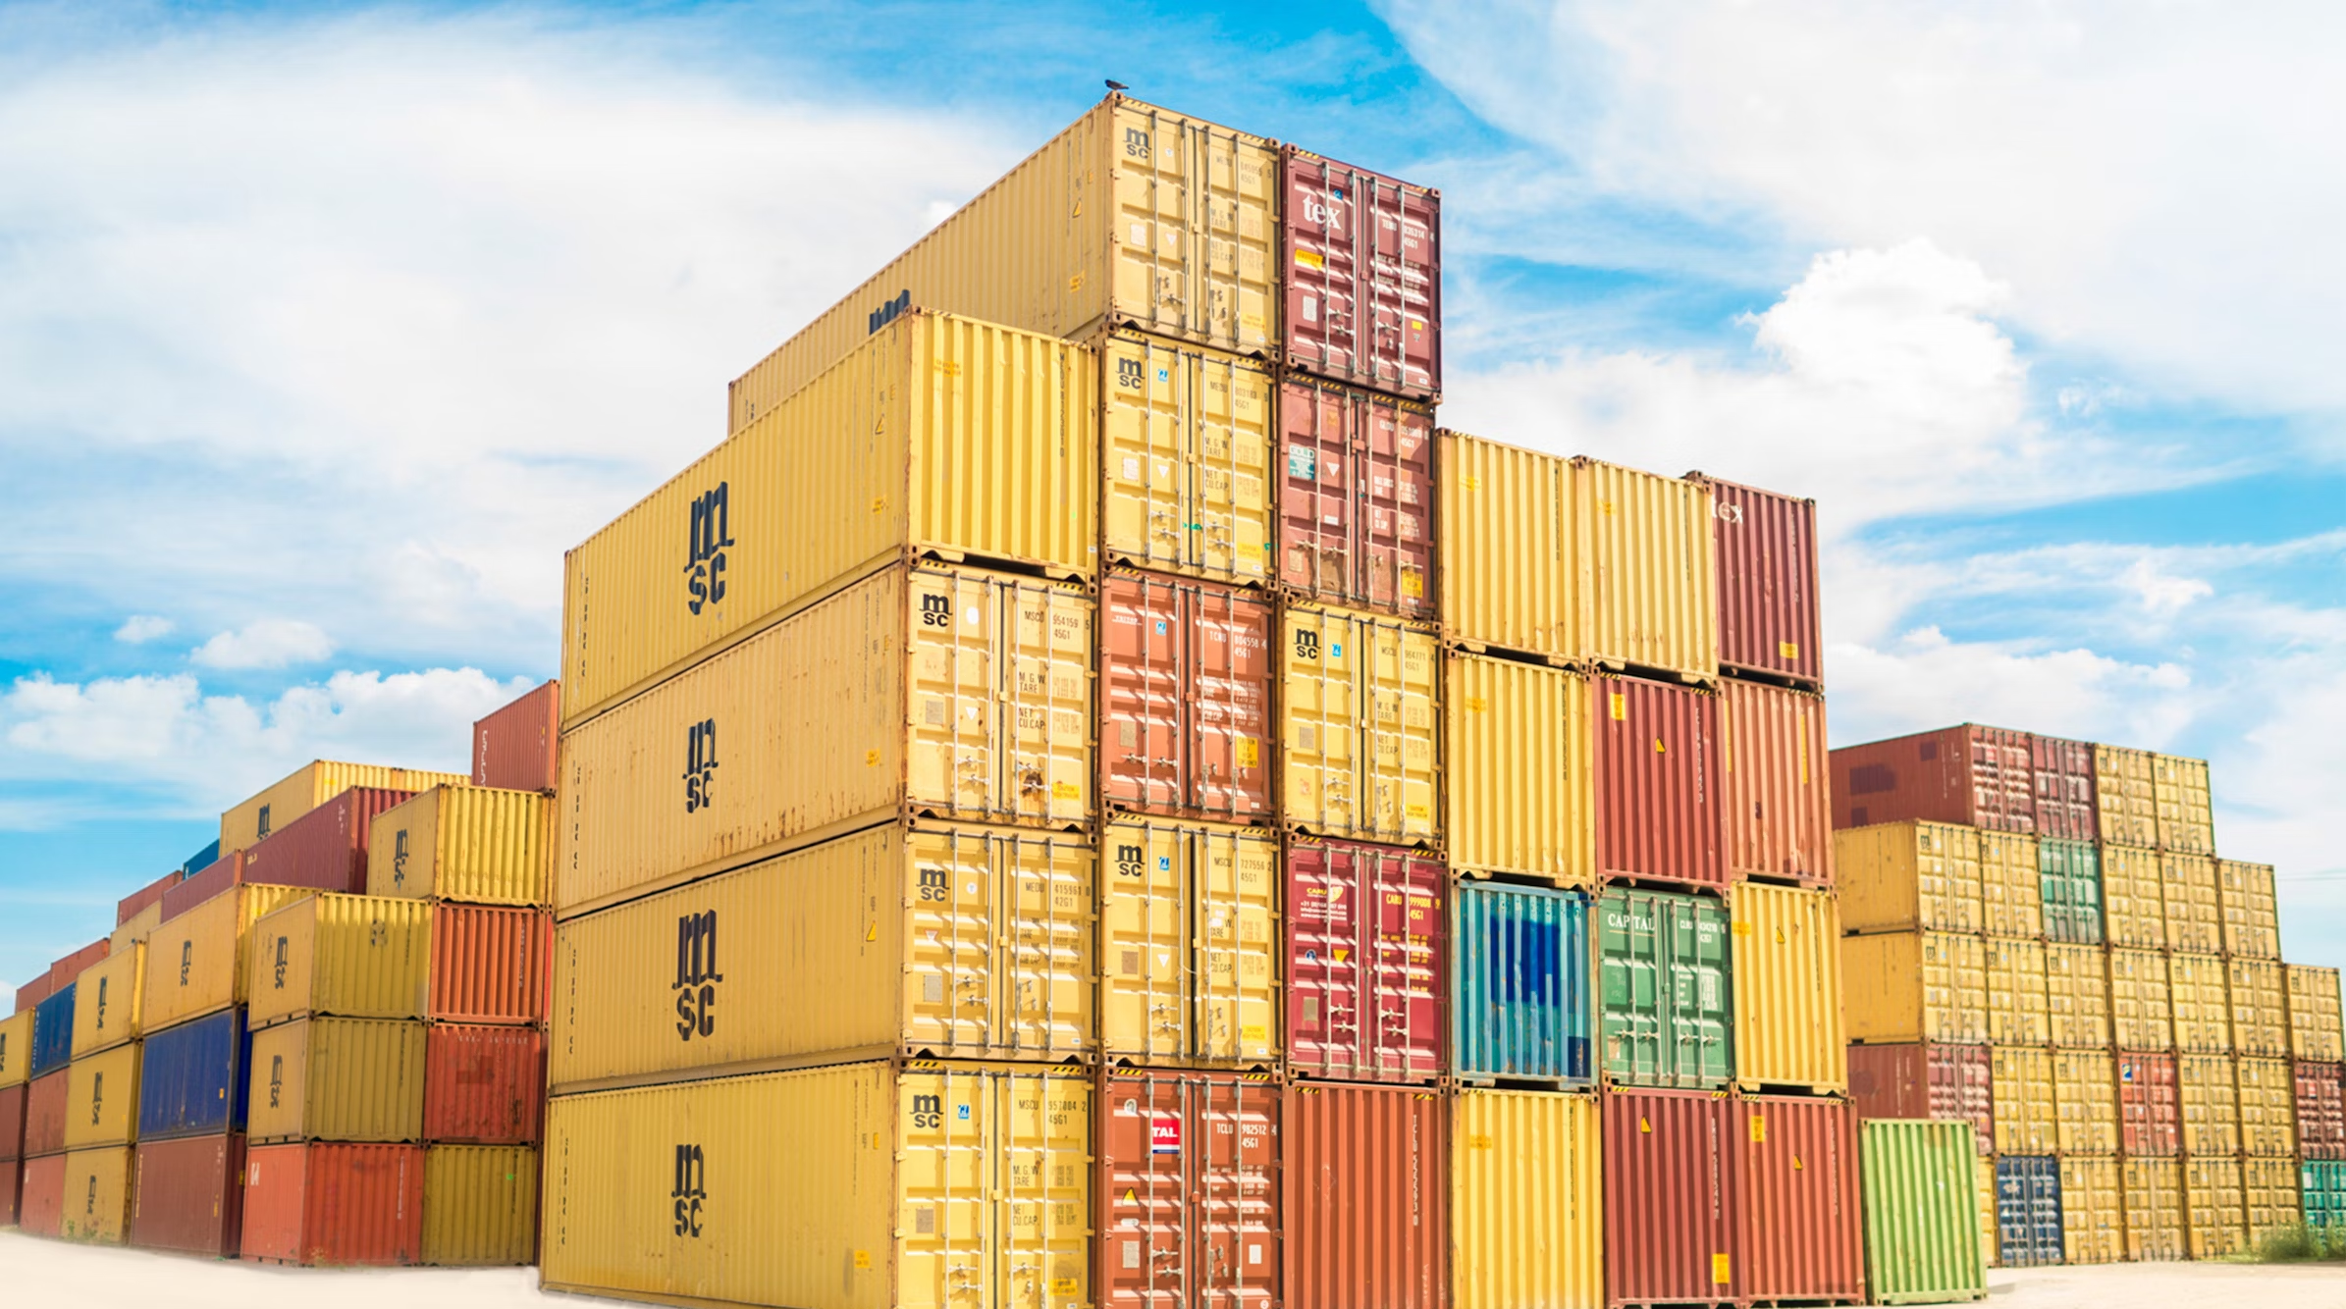
Think about the payload

Slide 3
At the end of my presentation
my audience will _____
Notes:
Inspire, reflect, learn …

Slide 4

Where my passion meets my expertise
Notes:
Hobbies,

Slide 5
What I like to do out side work
What is Trending
What the audience will remember
My personal life

